Slide 4
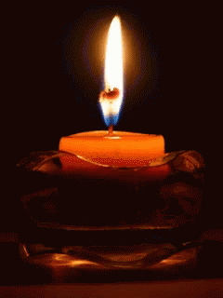
Lighting the Christ Candle

Slide 6
The Lord be with you
And also with you

Slide 7
Let us
pass the peace

Slide 9
1 Give thanks to the LORD,
for He is good; His love endures forever.
2 Let the redeemed of the LORD
say this — those he redeemed
from the hand of the foe,

Slide 10
3 those He gathered from the lands, from east and west,
from north and south.
4 Some wandered in desert wastelands, finding no way to a city
where they could settle.

Slide 11
5 They were hungry and thirsty, and their lives ebbed away.
6 Then they cried out to the LORD
in their trouble, and He delivered them
from their distress.

Slide 12
7 He led them by a straight way to a city where they could settle.
⁸ Let them give thanks to the Lord for His unfailing love and his wonderful deeds for mankind
Amen

Slide 14
Praise to the Lord, the Almighty,
the King of creation! O my soul, praise Him,
for He is your health and salvation! Come all who hear, brothers and sisters draw near; praise Him in glad adoration.
1/5

Slide 15
Praise to the Lord, who in all
things is wondrously reigning, and, as on the wings of an eagle
uplifting, sustaining.
Have you not seen all that is needed has been sent by His gracious ordaining.
2/5

Slide 16
Praise to the Lord,
who will prosper our work and defend us; surely His goodness and mercy
shall daily attend us. Ponder anew what the Almighty can do, as with His love He befriends us.
3/5

Slide 17
Praise to the Lord, who,
when darkness of sin is abounding, who, when the godless do triumph,
our best hopes confounding, sheds forth His light, scatters the horrors of night, saints with His mercy surrounding.
4/5

Slide 18
Praise to the Lord,
O let all that is in me adore Him! All that has life and breath,
come now with praises before Him. Let the amen sound from His people again, gladly for ever adore Him.
5/5
Words: Joachim Neander (1650-1680), 1680

Slide 21
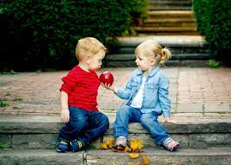

Slide 22
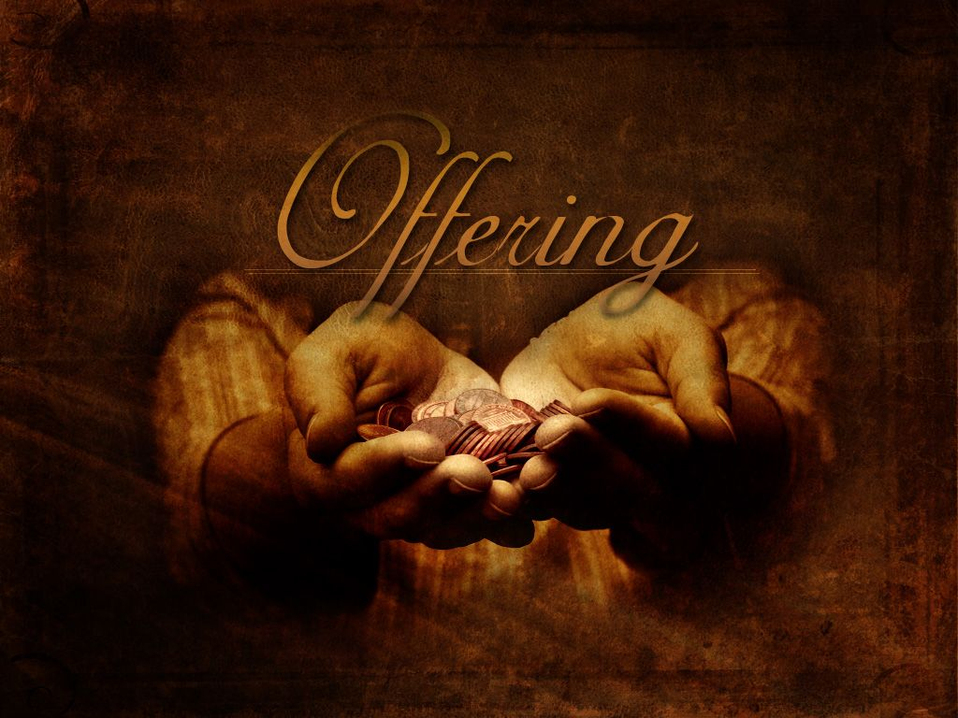

Slide 25
⁴ They traveled from Mount Hor along the route
to the Red Sea, to go around Edom.
But the people grew impatient on the way;
⁵ they spoke against God and against Moses,
and said,
“Why have you brought us up out of Egypt to die in the wilderness?
There is no bread! There is no water!
And we detest this miserable food!”

Slide 26
⁶ Then the Lord sent venomous snakes among them; they bit the people and many Israelites died. ⁷ The people came to Moses and said,
“We sinned when we spoke against the Lord
and against you. Pray that the Lord will take the snakes away from us.” So Moses prayed for the people.
⁸ The Lord said to Moses, “Make a snake and put it up on a pole; anyone who is bitten can look at it and live.”

Slide 27
⁹ So Moses made a bronze snake and put it up on a pole. Then when anyone was bitten by a snake and looked at the bronze snake, they lived.

Slide 30
¹⁴ Just as Moses lifted up the snake in the wilderness, so the Son of Man must be lifted up, ¹⁵ that everyone who believes may have eternal life in him.”
¹⁶ For God so loved the world that he gave his one and only Son, that whoever believes in him shall not perish but have eternal life.
¹⁷ For God did not send his Son into the world to condemn the world, but to save the world through him.

Slide 31
¹⁸ Whoever believes in him is not condemned,
but whoever does not believe stands condemned already because they have not believed in the name of God’s one and only Son. ¹⁹ This is the verdict: Light has come into the world, but people loved darkness instead of light because their deeds were evil. ²⁰ Everyone who does evil hates the light, and will not come into the light for fear that their deeds will be exposed.

Slide 32
²¹ But whoever lives by the truth comes into the light, so that it may be seen plainly that what they have done has been done in the sight of God.

Slide 34
Refrain
Comfort, comfort all my people
with the comfort of my word.
Speak it tender to my people:
All your sins are taken away.

Slide 35
Though your tears be rivers running,
though your tears be an ocean full,
though you cry with the hurt of living,
comfort, comfort.

Slide 36
Every valley shall be lifted,
every mountain shall be low,
every rough place will be smoother:
comfort, comfort.

Slide 37
Refrain
Comfort, comfort all my people
with the comfort of my word.
Speak it tender to my people:
All your sins are taken away.

Slide 38
Though your eyes see only darkness,
though your eyes can see no light,
though your eyes see pain and sorrow:
comfort, comfort.

Slide 39
Every night will have its morning,
every pain will have an end,
every burden will be lightened:
comfort, comfort.

Slide 40
Refrain
Comfort, comfort all my people
with the comfort of my word.
Speak it tender to my people:
All your sins are taken away.

Slide 42
¹⁴ Just as Moses lifted up the snake in the wilderness, numbers 21, so the Son of Man must be lifted up, for the healing of nations, ¹⁵ that everyone who believes may have eternal life, new life, born anew, in him. What does it mean to believe? When does eternal life begin?.”

Slide 43
¹⁶ For God so loved the world, Kosmos, lets make that personal, put your name here. that he gave his one and only Son, that whoever, no bias here, believes in him shall not perish but have eternal life. ¹⁷ For God did not send his Son into the world to CONDEMN the world, but to SAVE the world through him.

Slide 44
¹⁸ Whoever believes in him is not condemned, but whoever does not believe stands condemned already because they have not believed in the name of God’s one and only Son. ¹⁹ This is the verdict: Light has come into the world, but people loved darkness instead of light because their deeds were evil.

Slide 45
²⁰ Everyone who does evil hates the light, and will not come into the light for fear that their deeds will be exposed. ²¹ But whoever lives by the truth comes into the light, so that it may be seen plainly that what they have done has been done in the sight of God.

Slide 47
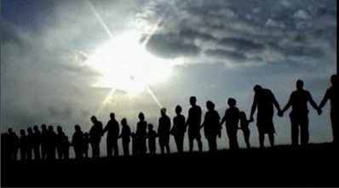
Prayers of the People

Slide 48
Our Father in heaven,
hallowed be Your name,
Your kingdom come,
Your will be done
On earth as in heaven.
Give us today our daily bread.

Slide 49
And forgive us our sins,
As we forgive those
who sin against us.
Save us from the time of trial,
And deliver us from evil.
For the kingdom, the power
and the glory are Yours,
Now and forever. Amen.

Slide 51
There’s a wideness in God’s mercy
Like the wideness of the sea,
And forgiveness in His justice
Sealed for us on Calvary.
1/5

Slide 52
There is plentiful redemption
In the blood that has been shed:
There is joy for all the members
In the sorrows of the Head.
2/5

Slide 53
For the love of God is broader
Than the measures of man’s mind;
And the heart of the Eternal
Is most wonderfully kind.
3/5

Slide 54
But we make His love too narrow
By false limits of our own,
And we magnify His strictness
With a zeal He will not own.
4/5

Slide 55
If our love were but more simple
We should take Him at His word;
And our lives would be illumined
By the goodness of our Lord.
5/5
John Stainer 1840-1901 Frederick William Faber 1814-63

